Slide 1
Statistics 367-1-4361 Linear Models
Opher Donchin

Slide 2
6.1 Effect sizes
The null hypothesis, raw effect sizes, normalized effect sizes

Slide 3
The null model
A default or naïve model
Usually:
No effect
No difference
No relationship
No influence
Can also be:
Any other state we want to test against
For a coin:
The coin has p=0.5

Slide 4
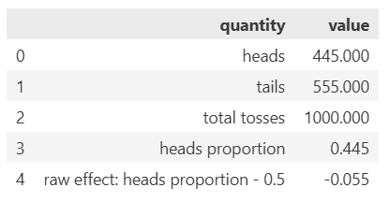
Effect size
The difference between reality and the null hypothesis
Raw effect size
In actual units of the data
Useful when there is domain knowledge
For a coin:
A difference between 0.5 and 0.45 looks impressive
Important distinction:
True effect size: reality
Measured effect size: data
Barto arXiv 2024

Slide 5
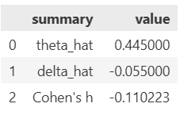
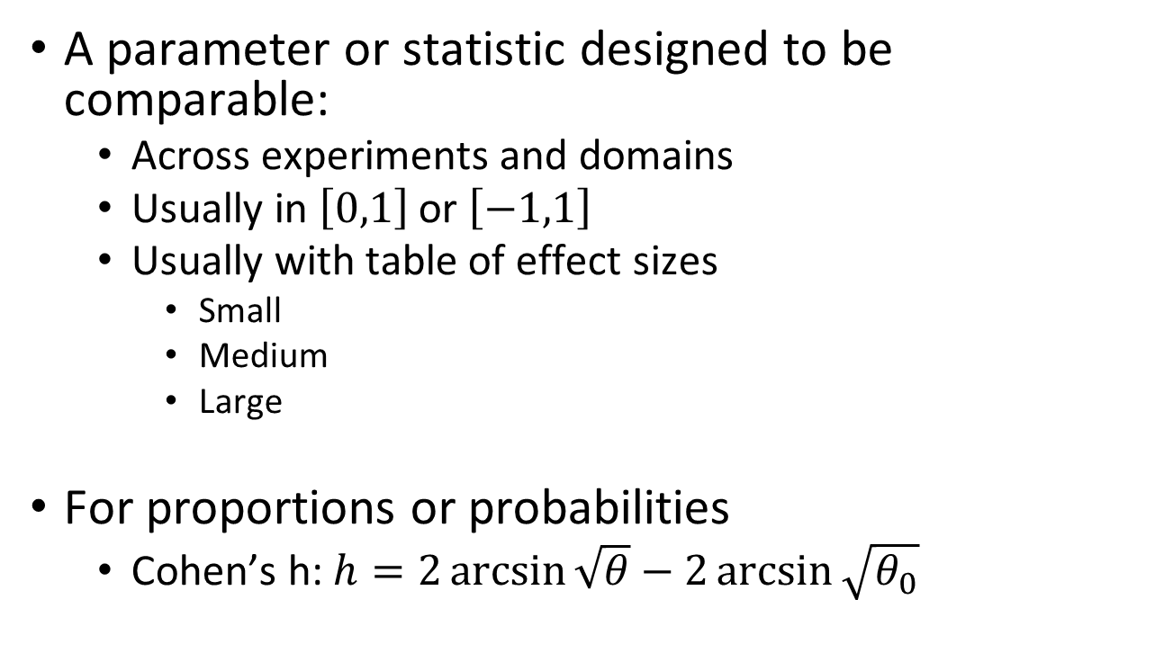
Normalized effect size
A parameter or statistic designed to be comparable:
Across experiments and domains
Usually in $\left[0,1\right]$ or $\left[−1,1\right]$
Usually with table of effect sizes
Small
Medium
Large
For proportions or probabilities
Cohen’s h: $h=2\arcsin{\sqrt{θ}}−2\arcsin{\sqrt{θ_{0}}}$
|Cohen’s h| | Effect size
0.2 | Small
0.5 | Medium
0.8 | Large

Slide 6
Raw vs normalized effect sizes
Raw effect size
Depends on domain knowledge
Useful for comparing similar experiments
Meaningful in application and impact
Carries greater weight for experts
Normalized effect size
Convenient for non-experts
Useful for comparing across fields
Helpful as a rule of thumb

Slide 7
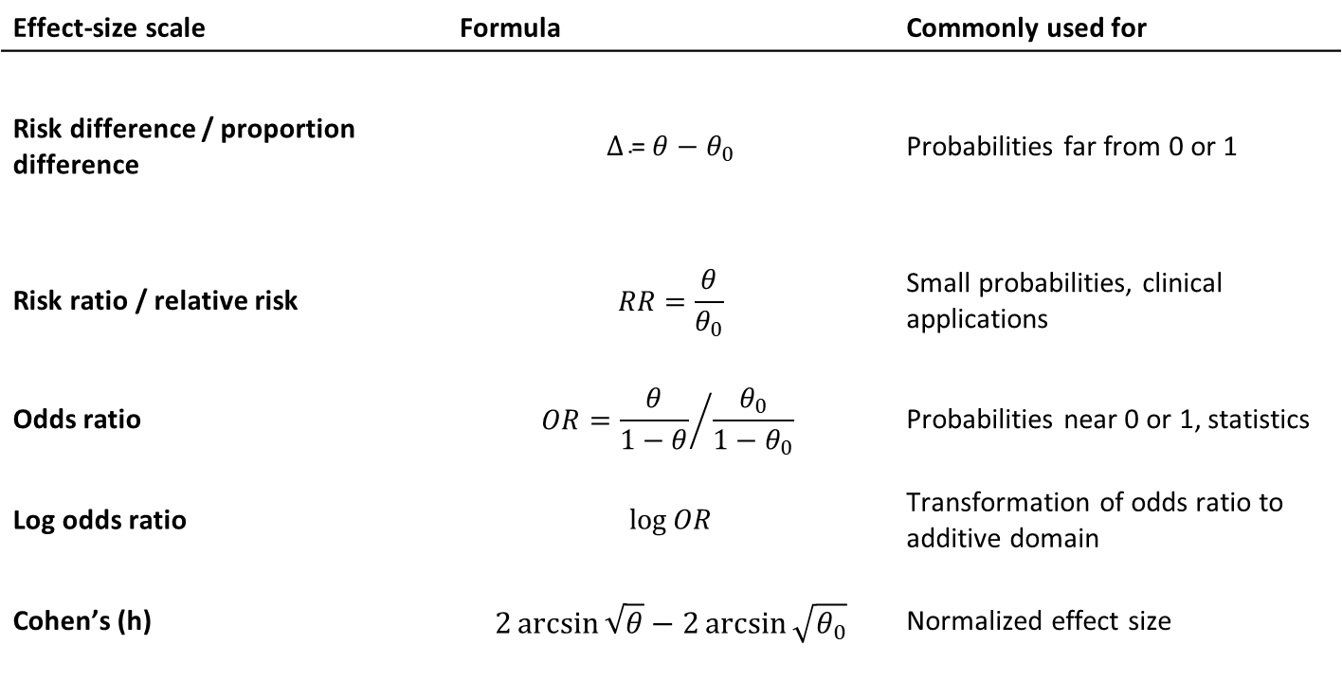
Many possible effect sizes
Effect-size scale | Formula | Commonly used for
Risk difference / proportion difference | $$Δ\text{ = }θ−θ_{0}$$ | Probabilities far from 0 or 1
Risk ratio / relative risk | $$RR=\frac{θ}{θ_{0}}$$ | Small probabilities, clinical applications
Odds ratio | $$OR={\frac{θ}{1−θ}}/{\frac{θ_{0}}{1−θ_{0}}}$$ | Probabilities near 0 or 1, statistics
Log odds ratio | $$\log{OR}$$ | Transformation of odds ratio to additive domain
Cohen’s (h) | $$2\arcsin{\sqrt{θ}}−2\arcsin{\sqrt{θ_{0}}}$$ | Normalized effect size

Slide 8
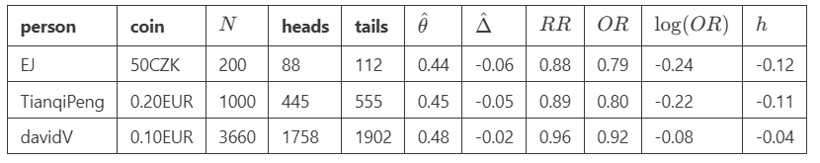
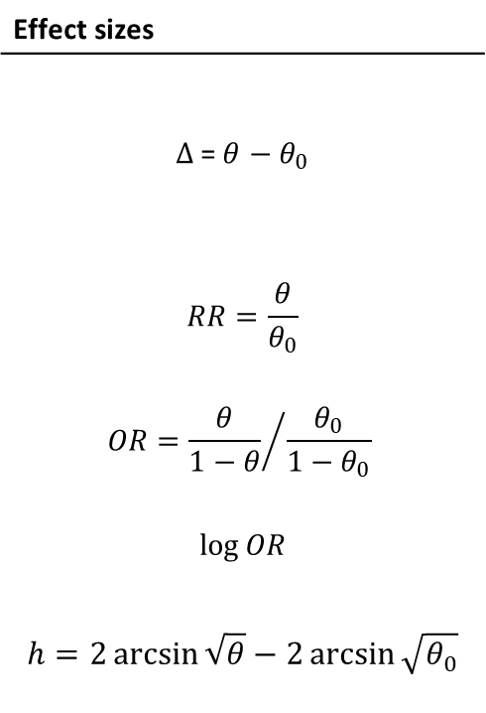
Estimated effect sizes can vary
Effect sizes
$$Δ\text{ = }θ−θ_{0}$$
$$RR=\frac{θ}{θ_{0}}$$
$$OR={\frac{θ}{1−θ}}/{\frac{θ_{0}}{1−θ_{0}}}$$
$$\log{OR}$$
$$h=2\arcsin{\sqrt{θ}}−2\arcsin{\sqrt{θ_{0}}}$$
The size of the estimated effect doesn’t depend on the amount of data

Slide 9
6.2 Hypothesis tests
What is a hypothesis test, Savage-Dickey

Slide 10
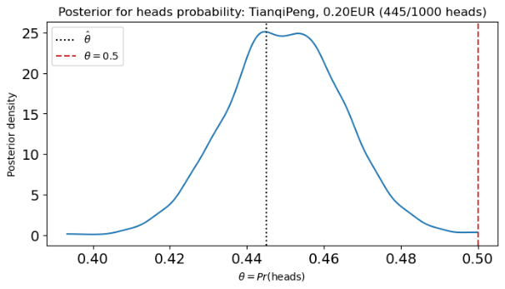
The null hypothesis and hypothesis testing
The null hypothesis is the hypothesis that the null model is true
“The effect size is 0”
If we can reject the null hypothesis
“Having seen the data, I doubt the null hypothesis”
Then there must be some effect
It may be small
It may not be interesting

Slide 11

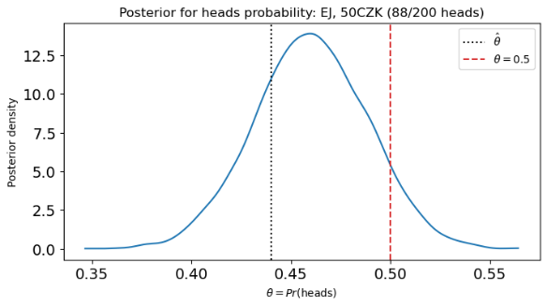
For hypothesis tests, the amount of data matters
With 1,000 coin tosses
The null hypothesis looks unlikely
With only 200
The null hypothesis is more credible

Slide 12
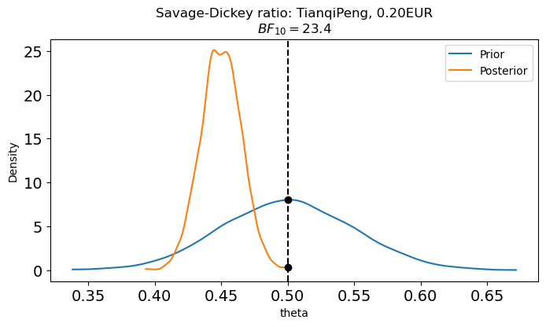
The Savage-Dickey density ratio
Ratio of prior and posterior density at a reference value
Measures evidence in data for or against that value
az.plot_bf(idata,var_name="theta")

Slide 13
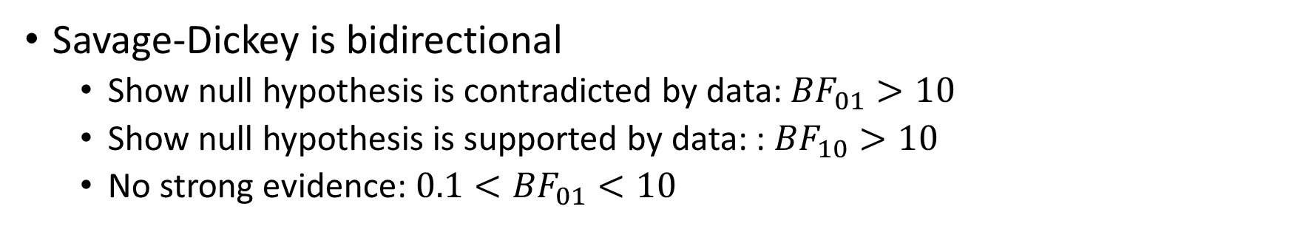
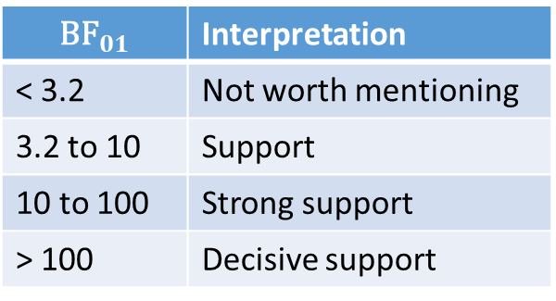
Interpreting the Savage-Dickey
Savage-Dickey is bidirectional
Show null hypothesis is contradicted by data: ${BF}_{01}>10$
Show null hypothesis is supported by data: : ${BF}_{10}>10$
No strong evidence: $0.1<{BF}_{01}<10$
$${\text{BF}}_{01}$$ | Interpretation
< 3.2 | Not worth mentioning
3.2 to 10 | Support
10 to 100 | Strong support
> 100 | Decisive support

Slide 14
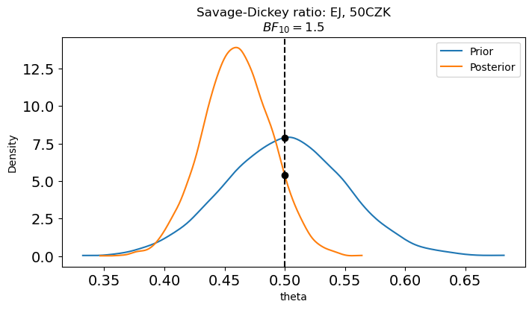
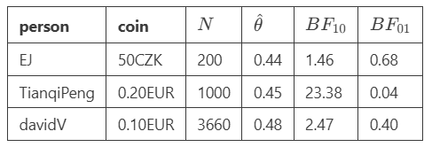
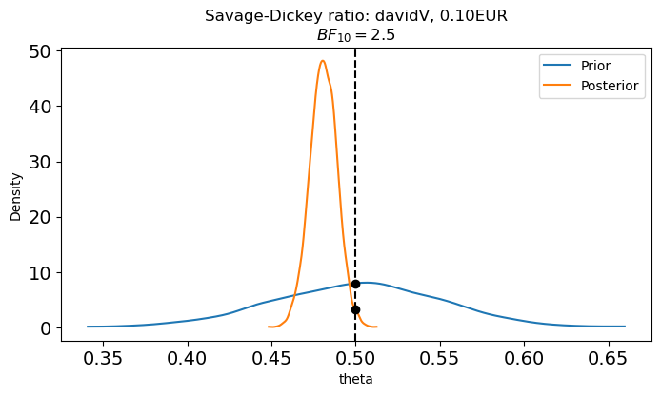
Savage-Dickey depends on effect size and sample size

Slide 15
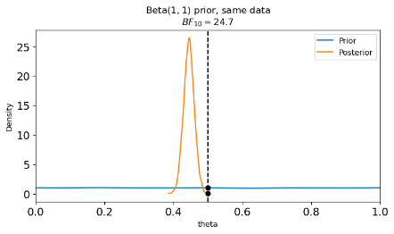
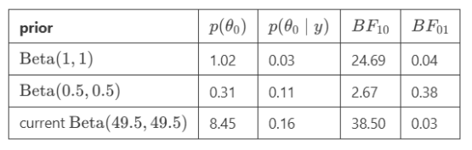
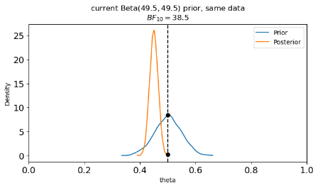
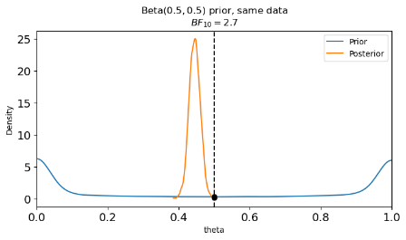
Savage-Dickey strongly affected by the prior

Slide 16
Hypothesis tests don’t measure effect size
Reject null hypothesis despite meaningless effects
Increasing life expectancy by a day
Affecting height by 2 mm
Fail to reject null hypothesis despite large effects
If N is small or data is noisy, null may be credible
But other possibilities may also be credible
And may be important

Slide 17
6.3 Baye’s factor
Effect of data on model credibility

Slide 18
Baye’s factor is part of the posterior odds
Posterior odds
Relative probability for two models
Baye’s factor
The part of posterior odds that depends on data
The ratio of the likelihoods
Posterior odds:
Likelihood under a model is averaged over the parameters

Slide 19
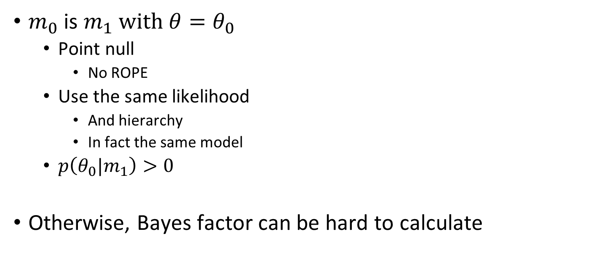
Savage-Dickey is Bayes factor unders specific conditions
$m_{0}$ is $m_{1} \text{with} θ=θ_{0}$
Point null
No ROPE
Use the same likelihood
And hierarchy
In fact the same model
$p\left(θ_{0}|m_{1}\right)>0$
Otherwise, Bayes factor can be hard to calculate

Slide 20

Bayes factor can be hard to interpret
Depends on prior
Like Savage-Dickey
Can be large even if both $p(m_{0})$ and $p(m)$ are small
That is:
Assumes the true hypothesis is in the family of hypotheses

Slide 21
6.4 ROPE and HDI test
Region of practical equivalence and its use in hypothesis tests

Slide 22
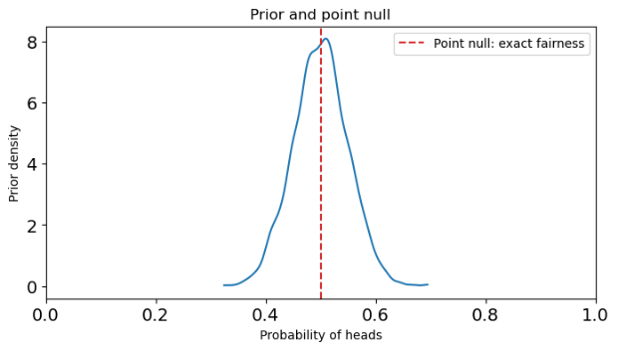
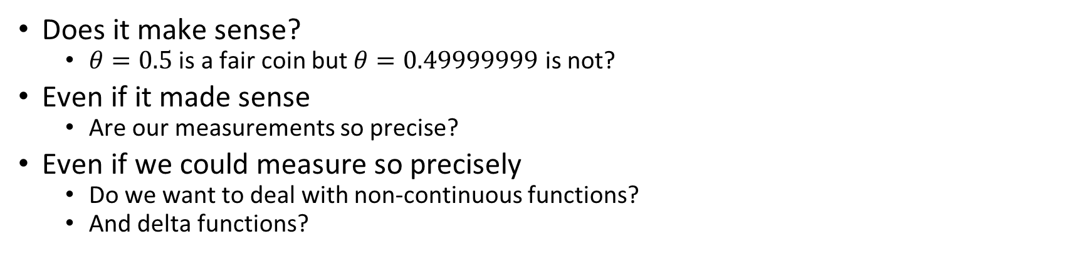
Point-null models can be unrealistic
Does it make sense?
$θ=0.5$ is a fair coin but $θ=0.49999999$ is not?
Even if it made sense
Are our measurements so precise?
Even if we could measure so precisely
Do we want to deal with non-continuous functions?
And delta functions?

Slide 23
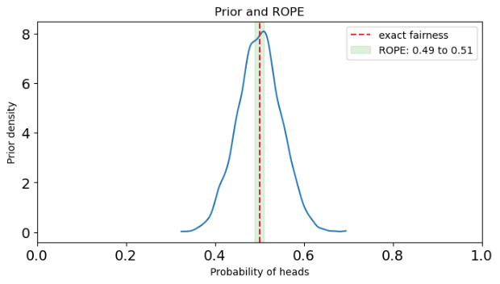
Region of Practical Equivalence (ROPE)
Region where null model is practically true
Specified arbitrarily
Domain knowledge is important
Ask:
What effect would be negligible even if real

Slide 24
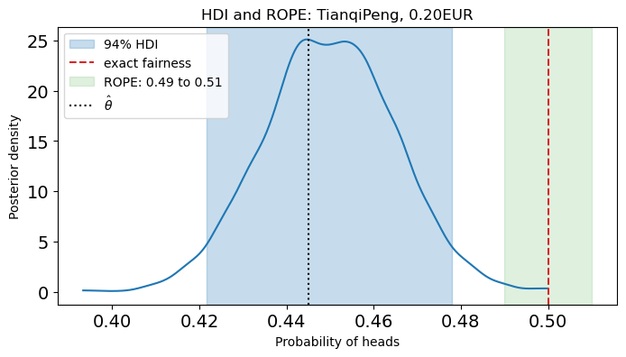
ROPE and HDI can be used for hypothesis test
If the HDI is outside the ROPE
Reject the null model

Slide 25
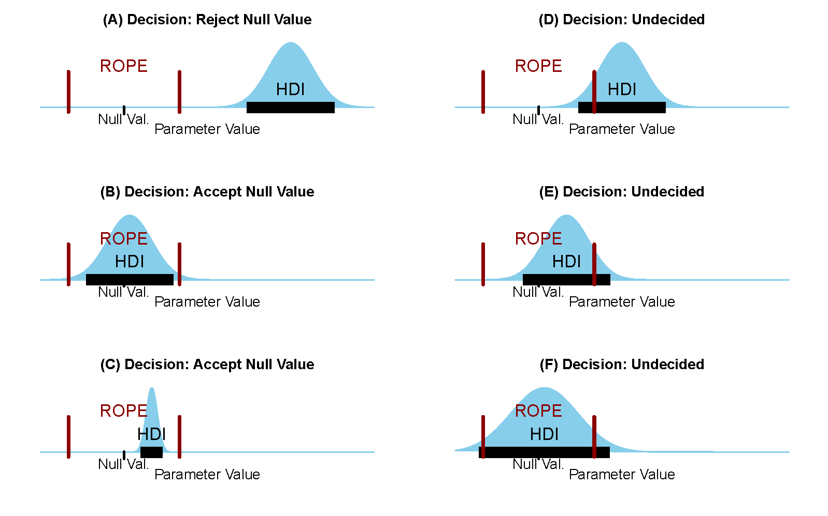
There are many possibilities for HDI / ROPE overlap
No overlap
Reject null
HDI in ROPE
Accept null
All other possibilities
No decision

Slide 26
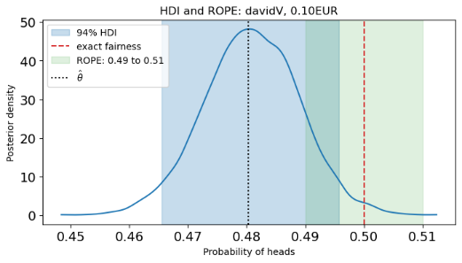
ROPE / HDI tests advantages and disadvantages
Sensitive to size of data
Additional data reduces uncertainty in the parameter
Reduces HDI
Easier to reject null value
This is true of all hypothesis tests
Less sensitive to prior
But dependent on arbitrary ROPE
Also aribitrary HDI percentage
More robust to very small effects
Because of ROPE

Slide 27
6.5 Significance
Type 1 error, significance threshold

Slide 28
Two kinds of error
Type I error / α error
Falsely rejecting a true null model
The null model says the coin is fair
Rejecting this: saying the coin is biased
False rejection: saying the coin is biased when it’s fair
Claiming an effect when there is no effect
The probability of type I error is the significance of the test

Slide 29
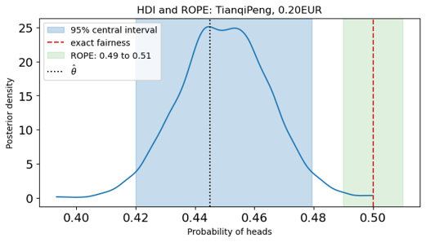
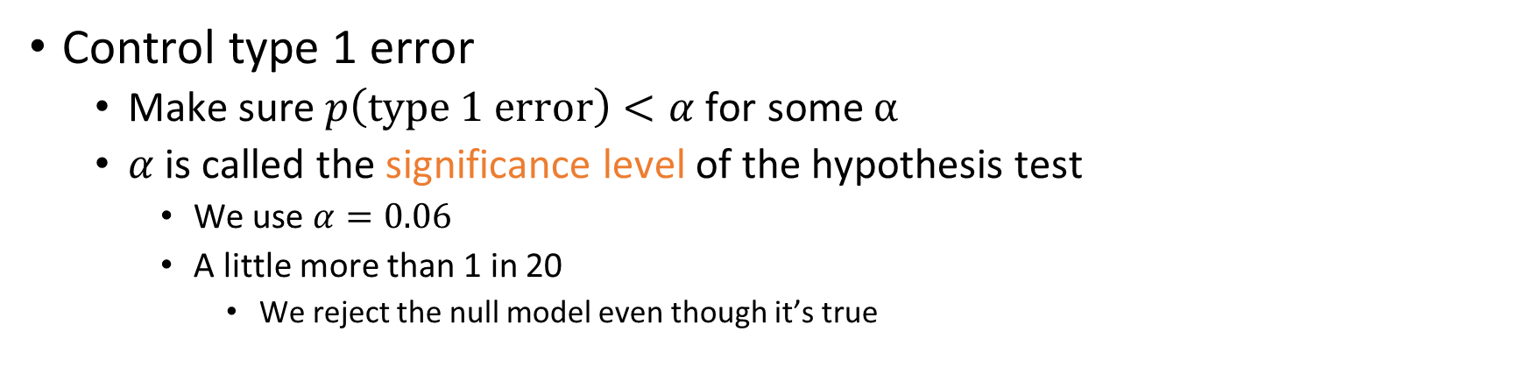
Significance threshold controls the probability of type 1 error
Control type 1 error
Make sure $p\left(\text{type}\text{ 1 }\text{error}\right)<α$ for some $α$
$α$ is called the significance level of the hypothesis test
We use $α=0.06$
A little more than 1 in 20
We reject the null model even though it’s true

Slide 30
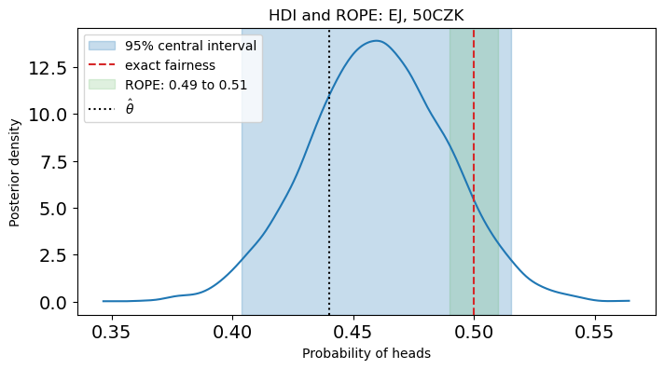
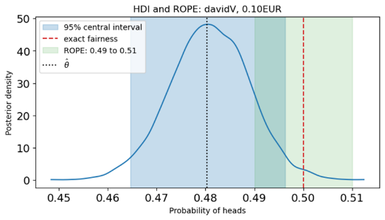
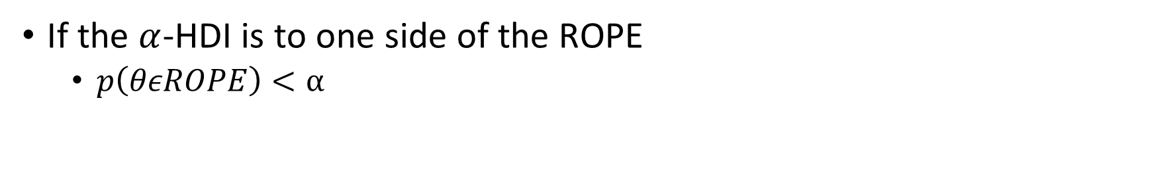
Overlap of HDI and ROPE implies lack of significance
If the $α$-HDI is to one side of the ROPE
$p\left(θεROPE\right)<α$

Slide 31
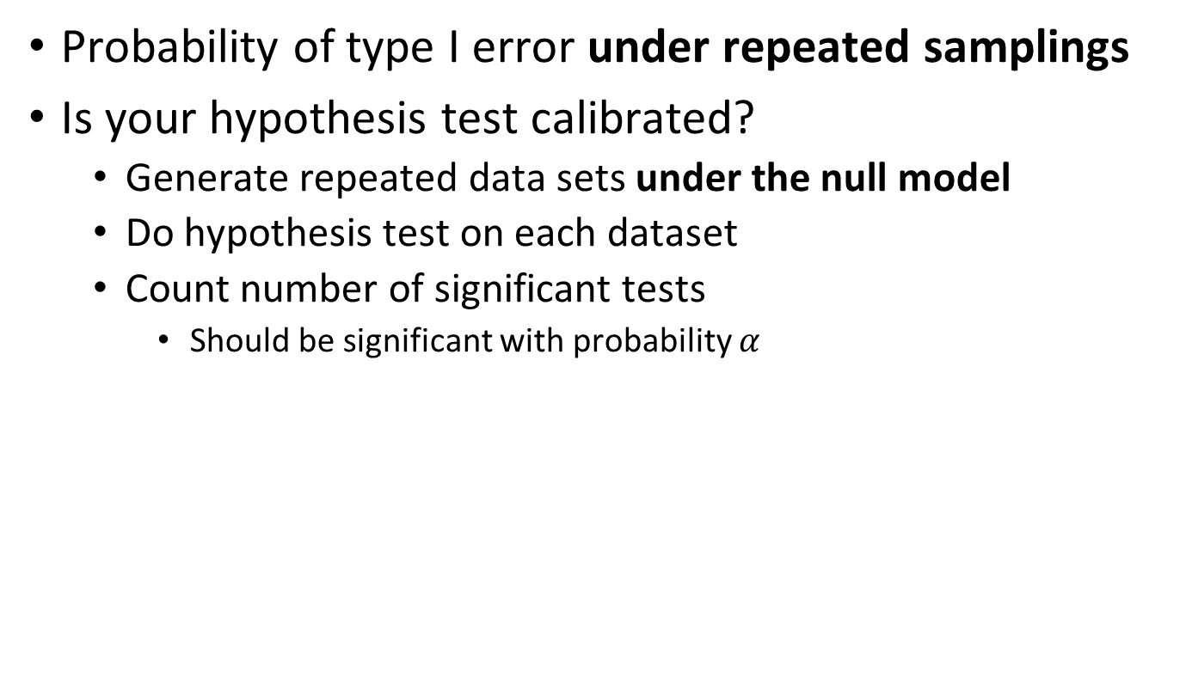
Significance is frequentist
Probability of type I error under repeated samplings
Is your hypothesis test calibrated?
Generate repeated data sets under the null model
Do hypothesis test on each dataset
Count number of significant tests
Should be significant with probability $α$

Slide 32
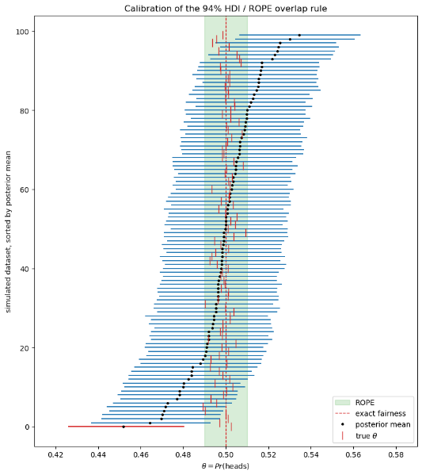
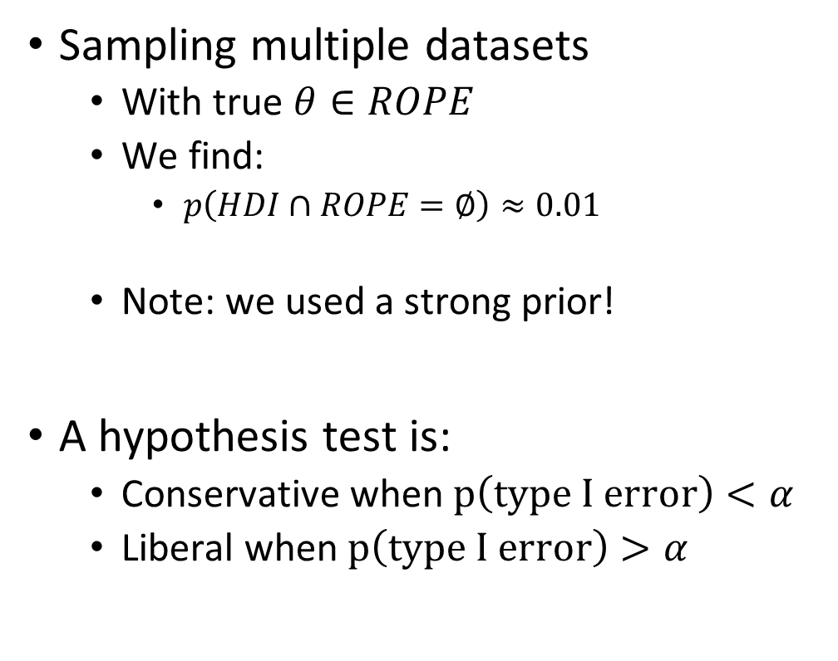
Our HDI / ROPE test is conservative
Sampling multiple datasets
With true $θ∈ROPE$
We find:
$p\left(HDI∩ROPE=∅\right)≈0.01$
Note: we used a strong prior!
A hypothesis test is:
Conservative when $p\left(\text{type} \text{I} \text{error}\right)<α$
Liberal when $p\left(\text{type} \text{I} \text{error}\right)>α$

Slide 33
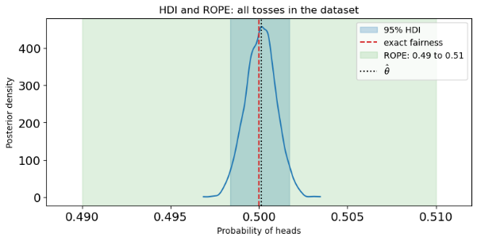
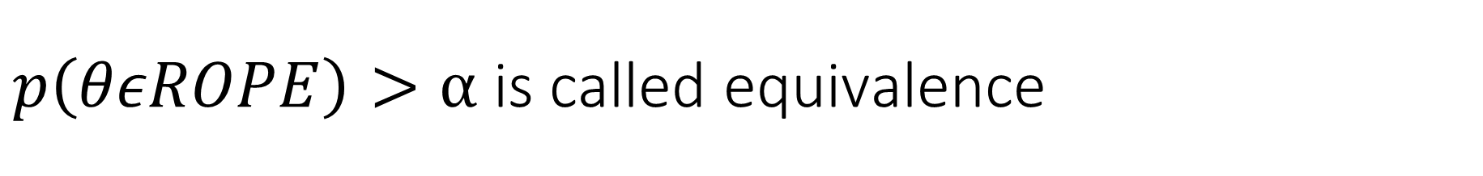
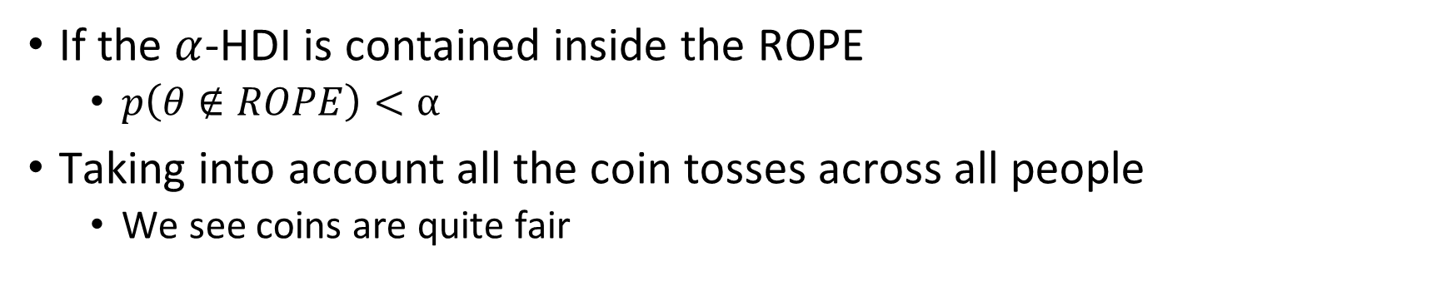
$p\left(θεROPE\right)>α$ is called equivalence
If the $α$-HDI is contained inside the ROPE
$p\left(θ∉ROPE\right)<α$
Taking into account all the coin tosses across all people
We see coins are quite fair

Slide 34
6.6 Basics of statistical reporting
Provide data, interval, effect size, and hypothesis test

Slide 35
Statistical reporting involves expectation
When you read a paper
What to expect
When you write a paper
Or a grant or a patent or an ethics request
What is expected of you

Slide 36
When do you need to report statistics?
Scientific reporting
Scientific paper
Grant application
Pre-registered research
Ethical approval
Medical reporting
Approval for drug or treatment
Ethical approval
Engineering
Patent application
Ethical approval

Slide 37
Different reporting standards
There are often strict rules about statistical reporting
Always check
When there are no rules, there are norms
Reporting for clinical trials is strict
Reporting for registering experiments is relaxed
Rules and norms change over time
Check recent publications or applications

Slide 38
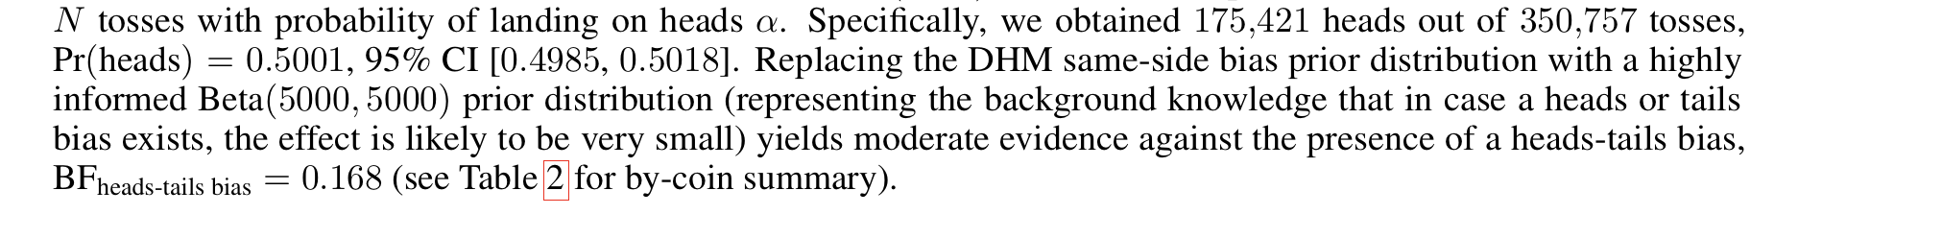
The most basic level of reporting
What did you measure?
What is your parameter estimate?
How is your interval?
What is the effect size?
Is the effect significant?

Slide 39
6.7 Power
Can we identify a true effect?

Slide 40
Two kinds of error
Type I error / α error
Falsely rejecting a true null model
Type II error / β error
Failing to reject a false null model
Overlooking a real difference
Being overly cautious
The power of the test
Smaller probability of type II error
→ more powerful test

Slide 41
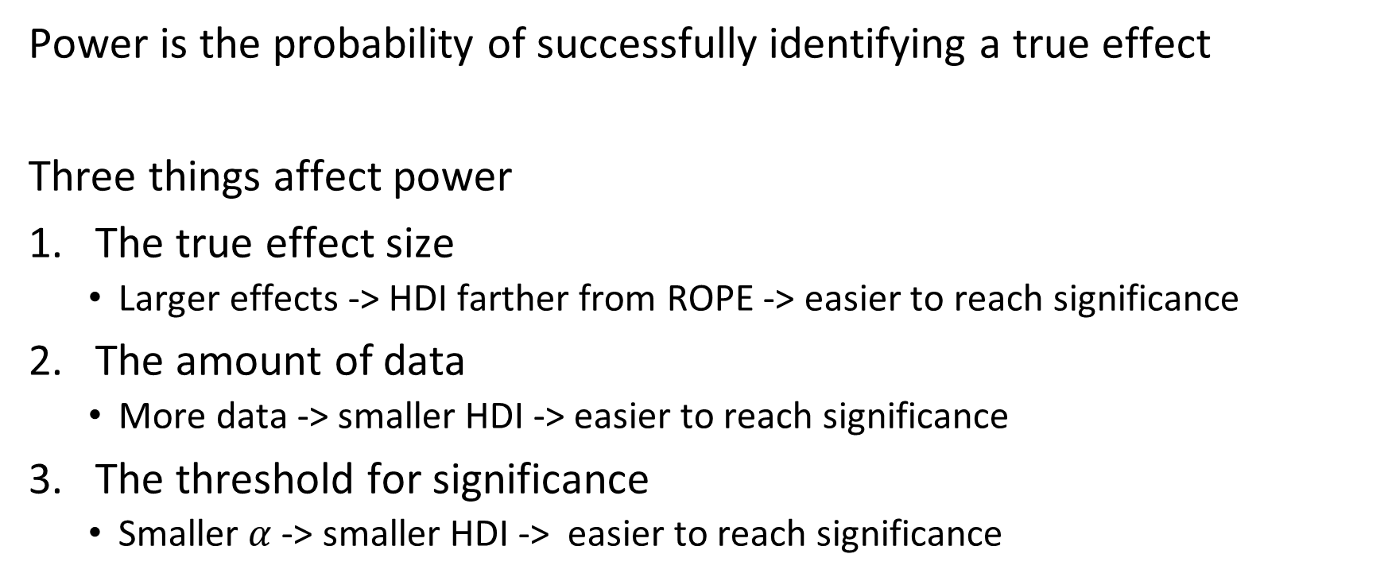
Power depends on effect size, sample size, and significance threshold
Power is the probability of successfully identifying a true effect
Three things affect power
The true effect size
Larger effects -> HDI farther from ROPE -> easier to reach significance
The amount of data
More data -> smaller HDI -> easier to reach significance
The threshold for significance
Smaller $α$ -> smaller HDI -> easier to reach significance

Slide 42
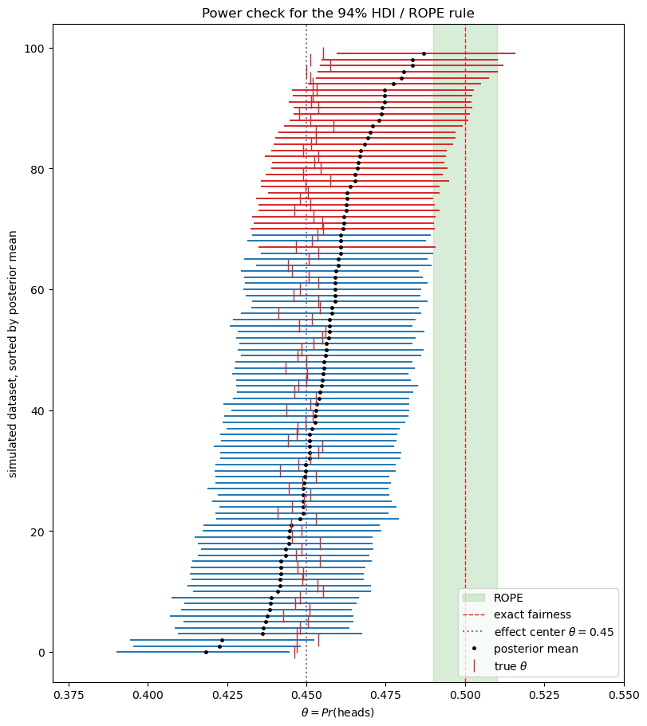
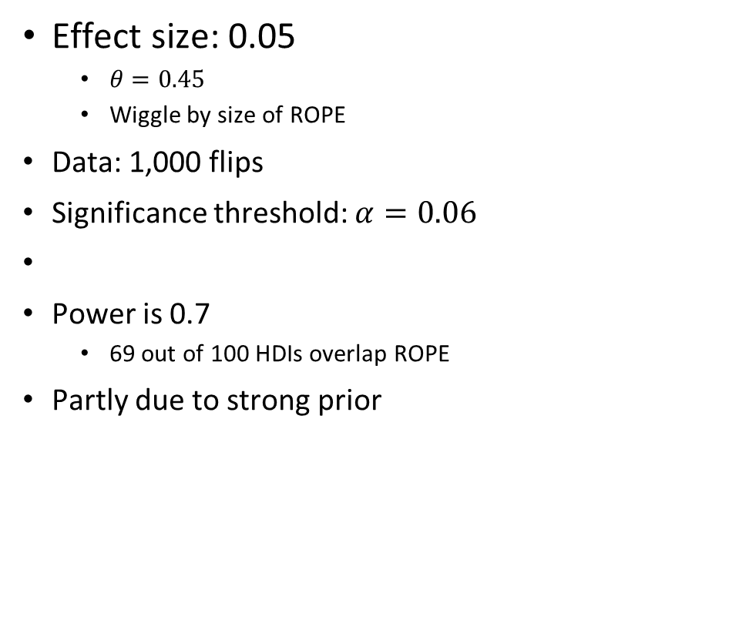
Example: power of a test
Effect size: 0.05
$θ=0.45$
Wiggle by size of ROPE
Data: 1,000 flips
Significance threshold: $α=0.06$
Power is 0.7
69 out of 100 HDIs overlap ROPE
Partly due to strong prior

Slide 43
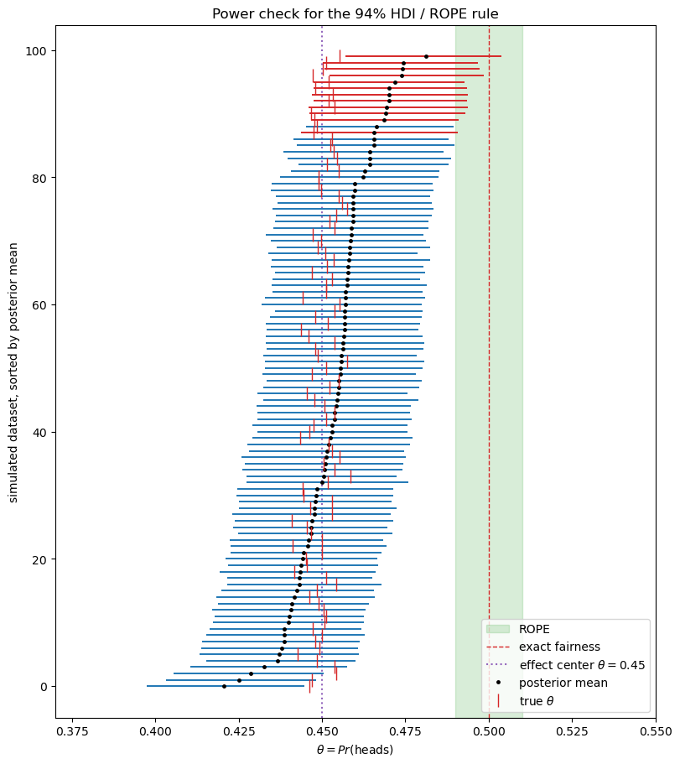

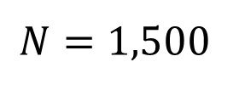
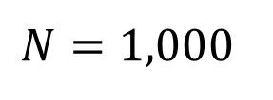
Power under increased N
$$N=1,500$$
Increasing $N$ to 1,500
Power increases to 0.9
$$N=1,000$$

Slide 44
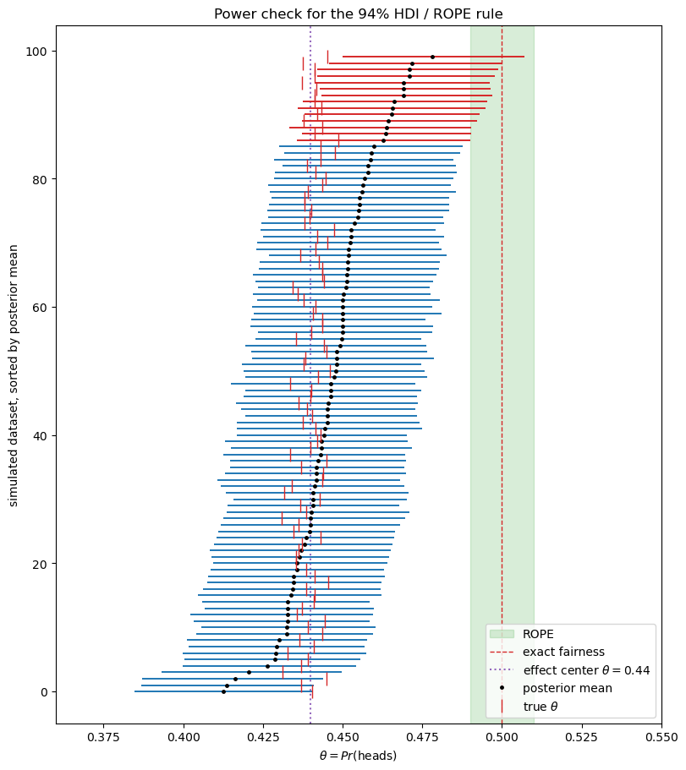



Power under increased effect
Increasing effect size to 0.06
Power increases to 0.86
$$Δ=0.06$$
$$N=1,000$$
$$N=1,500$$

Slide 45
6.8 Pre-hoc and post-hoc power
How much data do we need? How big an effect can we measure?

Slide 46
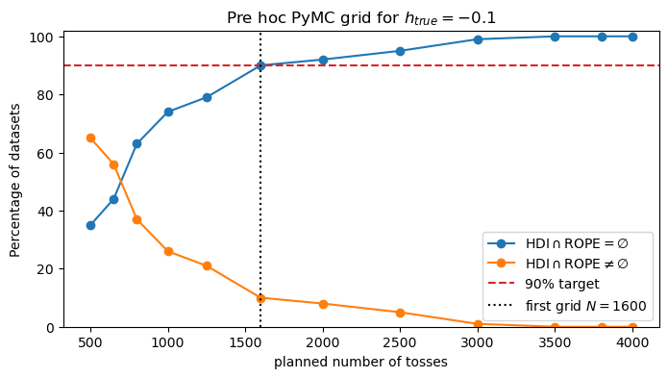
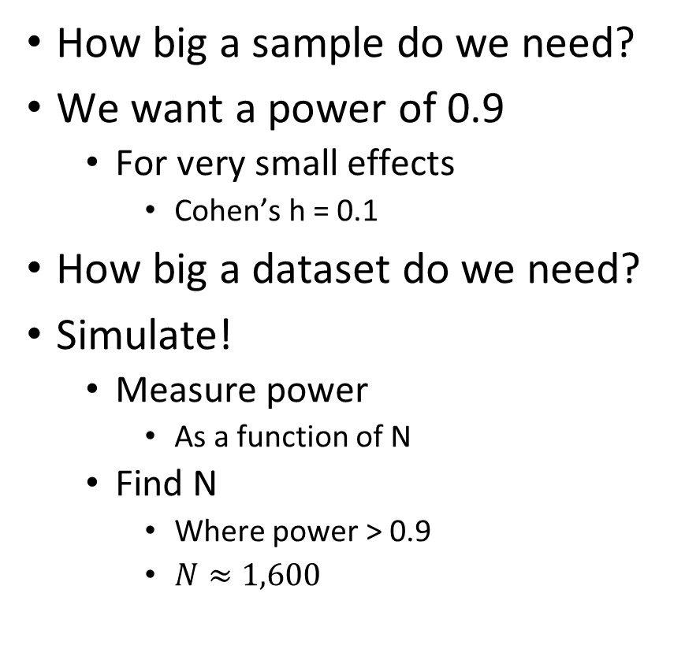
Pre-hoc power: choosing N to get enough power
How big a sample do we need?
We want a power of 0.9
For very small effects
Cohen’s h = 0.1
How big a dataset do we need?
Simulate!
Measure power
As a function of N
Find N
Where power > 0.9
$N≈1,600$

Slide 47
Choosing pre-hoc effect size
Go to the literature
Look at similar studies
What sort of effects do people get
Conduct a preliminary study
Get data from a small number of people
Estimate the effect size
What is a meaningful minimal effect?
Think about what’s important
Leads to larger (and more appropriate) sample sizes

Slide 48
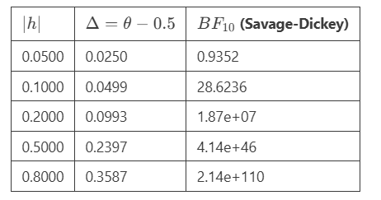
Rule of thumb for ROPEs and minimal effects
Set minimal effect size to half of a small effect
Set ROPE to half of the minimal effect size

Slide 49
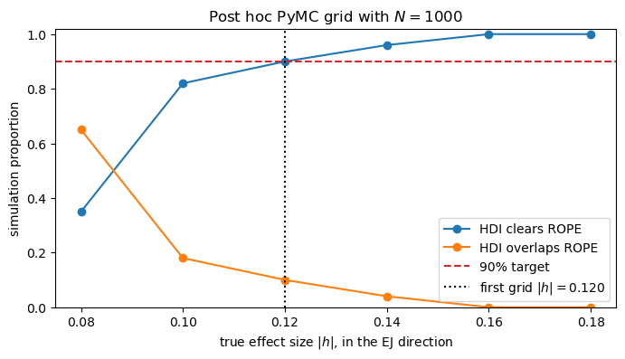
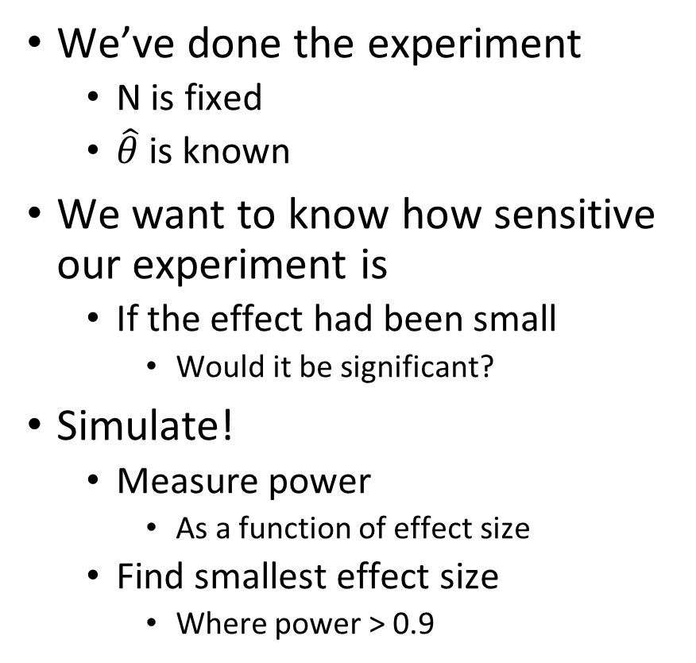
Post-hoc power: how big an effect do we need?
We’ve done the experiment
N is fixed
$\hat{θ}$ is known
We want to know how sensitive our experiment is
If the effect had been small
Would it be significant?
Simulate!
Measure power
As a function of effect size
Find smallest effect size
Where power > 0.9

Slide 50
6.9 Frequentist methods
The z statistic. Its sampling distribution. Frequentist power analysis.

Slide 51

Frequentist hypothesis tests use a statistic
Find a statistic
Whose sampling distribution is known
Under the null hypothesis
Test whether calculating the statistic on our data is consistent
With the null sampling distribution
That means:
Is measured statistic
Is in tail
Of null sampling distribution

Slide 52


The $z$ statistic is approximately normally distributed
Calculate $\hat{θ}=\frac{y}{N}$
$y$ is the number of successes
Calculate $z$
If $θ=θ_{0}$ and $N$ is large
$z∼N\left(0,1\right)$

Slide 53



Use the $z$ statistic to test if data is consistent with null
Calculate $\hat{θ}=\frac{y}{N}$
$y$ is the number of successes
Calculate $z$
If $θ=θ_{0}$ and $N$ is large
$z∼N\left(0,1\right)$
So if $z<−1.88$ or $z>1.88$
Reject null hypothesis

Slide 54

Different hypothesis tests don’t always agree
TianqiPeng was significant for z test and HDI / ROPE
EJ was not significant for either z test or HDI / ROPE
DavidV was significant for z test but not for HDI / ROPE

Slide 55

p values measure how unlikely data is under the null
The integral of the tails
The probability of getting data
As extreme as the real data
Or more extreme
Under the null model

Slide 56

Differences between hypothesis tests
Bayesian
Frequentist
Can use $p\left(θ|y\right)$
Can use interval null
Focused on what we know given data and prior
Requires fitting a model
Appropriateness check by Bayesian workflow
Must use sampling distributions
Uses point null
Focused on sampling distribution of statistic under null model
Requires calculating a statistic
Appropriateness checked by explicit conditions

Slide 57


Power analysis
Frequentist power analysis is the same as Bayesian power analysis
Using a specific value for the parameter, not a distribution
Using a frequentist hypothesis test
Against a point null

Slide 58
6.10 Comparing two groups
Effect size, hypothesis test, and power analysis

Slide 59


Does PCI improve outcomes?
Some NYC hospitals have percutaneous coronary intervention (PCI) capabilities
More common in larger hospitals
Do they actually improve outcome?

Slide 60

We can use a hierarchical model
The same model used last lecture
Last lecture for neighborhoods
Here for PCI / non-PCI

Slide 61


Extend the model to calculate the difference
We can use calculations inside the model to get quantities of interest
mu_nonpci = pm.Deterministic("mu_nonpci", mu_type[0])
mu_pci = pm.Deterministic("mu_pci", mu_type[1])
mu_difference = pm.Deterministic("mu_difference", mu_pci - mu_nonpci)
Deterministic parameters go into the idata object

Slide 62

Effect sizes are very small
Indeed, the HDI of the effect sizes contains null value
So HDI of effect size will overlap ROPE

Slide 63

Comparing HDI to ROPE does not allow conclusions
HDI intersects with ROPE
ROPE does not contain HDI

Slide 64

A pre hoc power analysis to determine precision
Instead of asking about significance
Ask about width of HDI
How does width of HDI change as number of hospitals grows?

Slide 65

A post hoc power analysis for sensitivity
How big would the effect need to be for us to see it
We have enough hospitals to see even very small effects

Slide 66
Frequentist hypothesis test for comparison of two groups
Based on same normal approximation

